Slide 1
Lane Detection & Object Avoidance
DMGD S-17 Team 1 Summer 2020
August 4th, 2020

Slide 2
Team Members
Khalid Aliweh
Zane Hernandez
Ishaan Bhagat
Alejandro Montero
Favion Harvard
Asia Vines
Oscar Anchondo

Slide 3
Project Goal
Develop an autonomous driving system that is able to detect the lanes on a given road, steer a robot and avoid any obstacles on that road based on the data from one sensor only (camera)

Slide 4
Equipment & Setup
Robots:
Jetbot built from scratch using the Bill-of Materials
Waveshare Jetbot AI Kit
Sparkfun Jetbot AI Kit
Tracks:
Ready tracks (O shaped)
Handmade tracks (O & L shaped)

Slide 5
Milestones
Project Kickoff & Planning
Robot Assembly (Hardware and Software)
Track Assembly
Research & Experimentation
Machine Learning (Data Collection/Labeling, Training and testing)
Validate the results and adjust the approach as needed

Slide 6
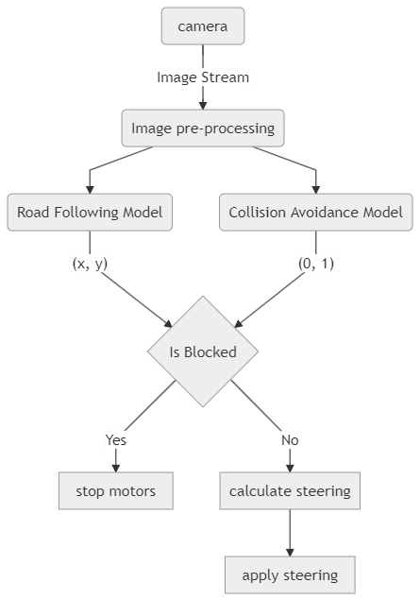
Flowchart

Slide 7
Lane Detection
Final Method: Leverage Transfer Learning to finetune a pretrained Resnet18 model after replacing the last fully connected layer to output our two classes (X, Y) and retraining the model with our datasets
Final Dataset: 500+ labeled images for the bot in different poses on the track.
Training: 50 epochs
Other Experiments: Resnet18 from scratch, Resnet18 as a feature classifier, Resnet34 pretrained

Slide 8
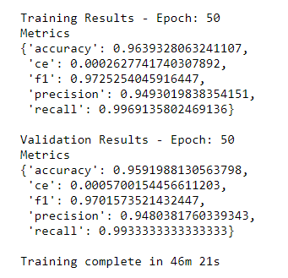
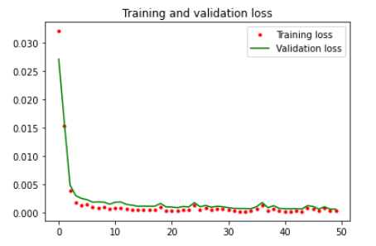
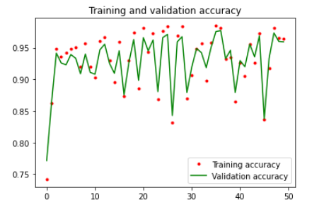
Lane Detection Results
The average validation accuracy for the last 10 epocs is 92.8%

Slide 9
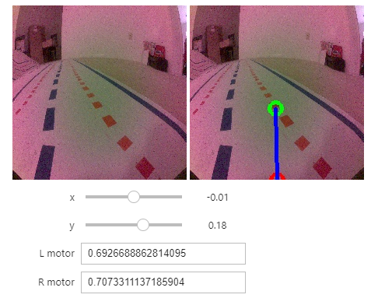
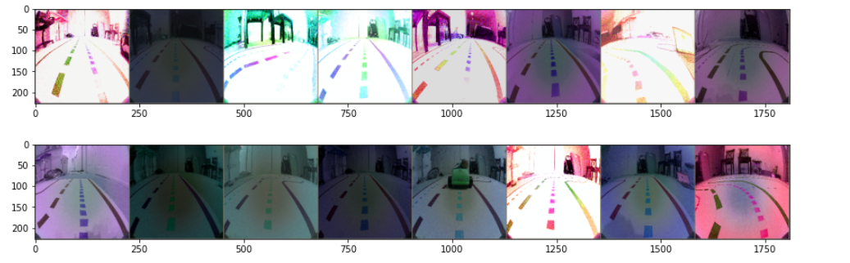
Lane Detection Challenges
Dataset Size: The process of collecting/labeling the data is time consuming and requires consistency between the images to produce the good results.
Solution: Leverage image augmentation techniques to generate the training data
Turns: The bot struggled with turns
Solutions:
Decode and understand the relationship between the x,y angle and the motor thrust
Collect more data for the turns
Adjust the PID controller parameters

Slide 10
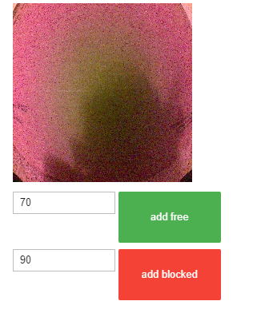
Obstacle Avoidance
Method: Modify the Alexnet model to our use case (2 outputs) and leverage Transfer learning to finetune the pretrained model
Dataset: Less than 200 Images for the bot in blocked and free positions both on the track and outside it.
Training: 30 epochs

Slide 11
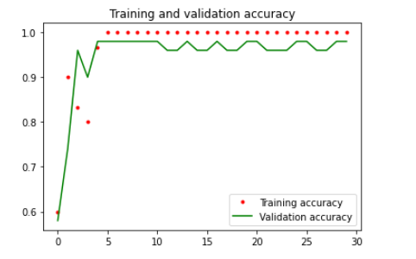
Obstacle Avoidance Results
The average validation accuracy for the last 10 epocs is 97.0%

Slide 12
Future Endeavors
Combine the data from all the tracks and retrain both models in different environments (Lighting conditions, missing lanes, etc)
Leverage a rotary encoder and use a proper PID controller function to make the bots move as smooth as possible
Modify and retrain the Obstacle Avoidance model to detect more classes (free, blocked, left lane free, right lane free, stop sign ahead, road intersection ahead)

Slide 13
Demos
https://youtu.be/i5l7NZMESuA
https://youtu.be/j1x1JDPp2Rw

